Slide 1
San Gabriel Data Collection/Analysis System
Mannan Anand, Maddox Pealock, Nathan Sheyman

Slide 2
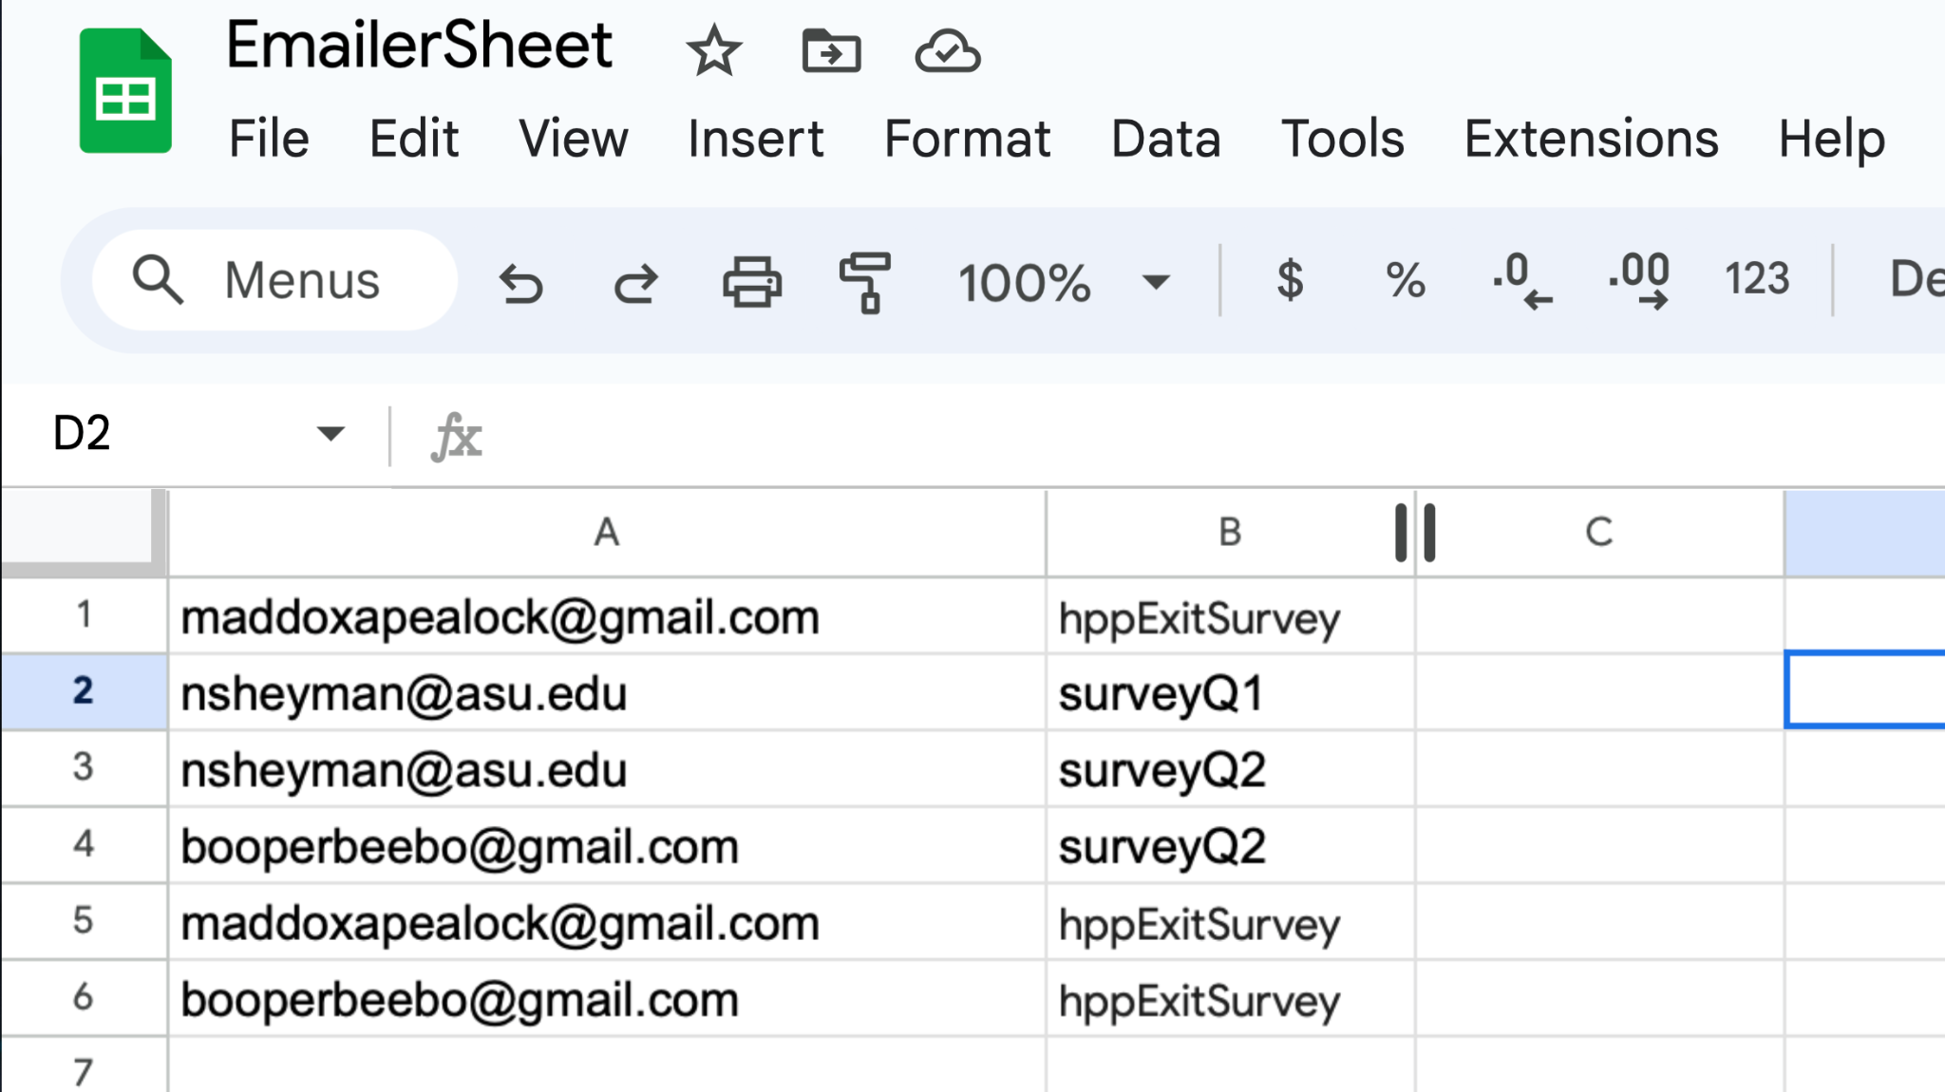
Auto Emailer

Slide 3
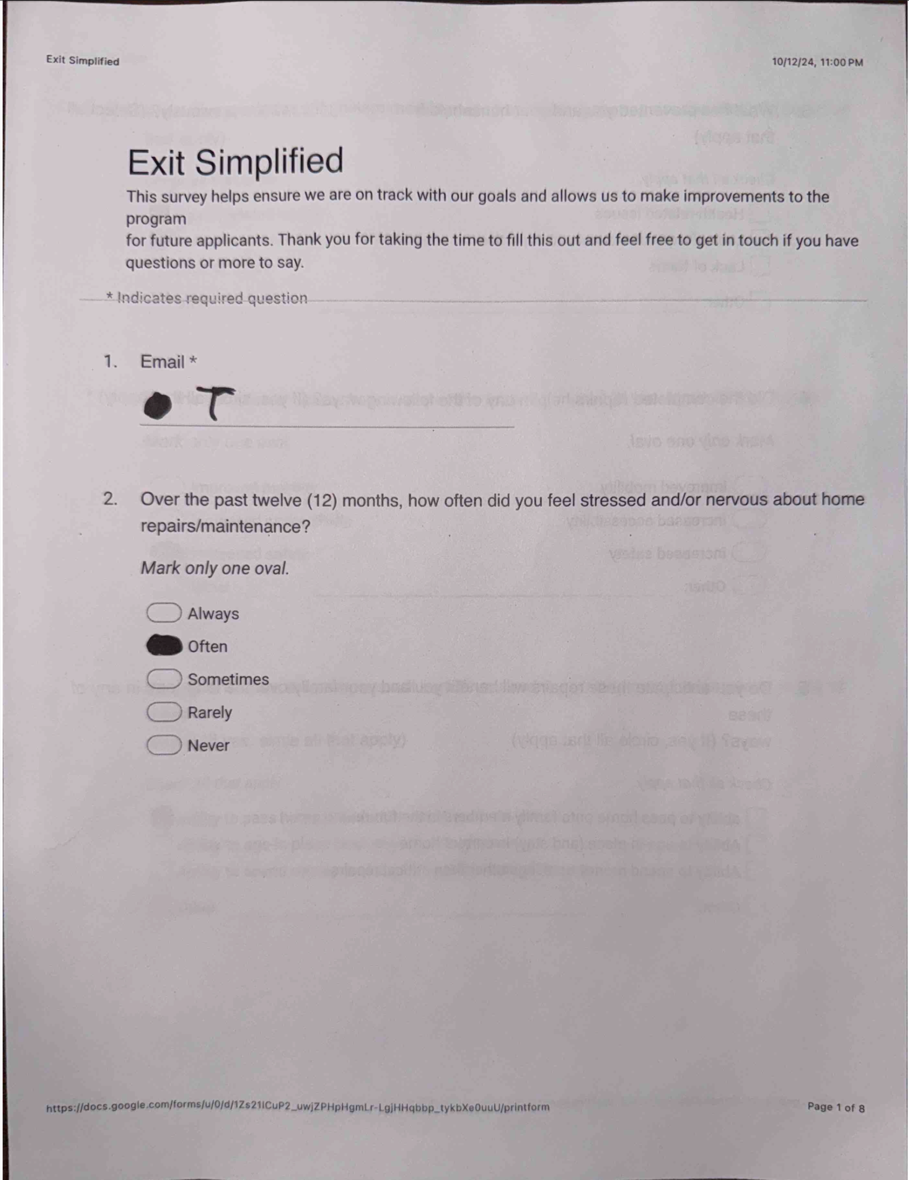
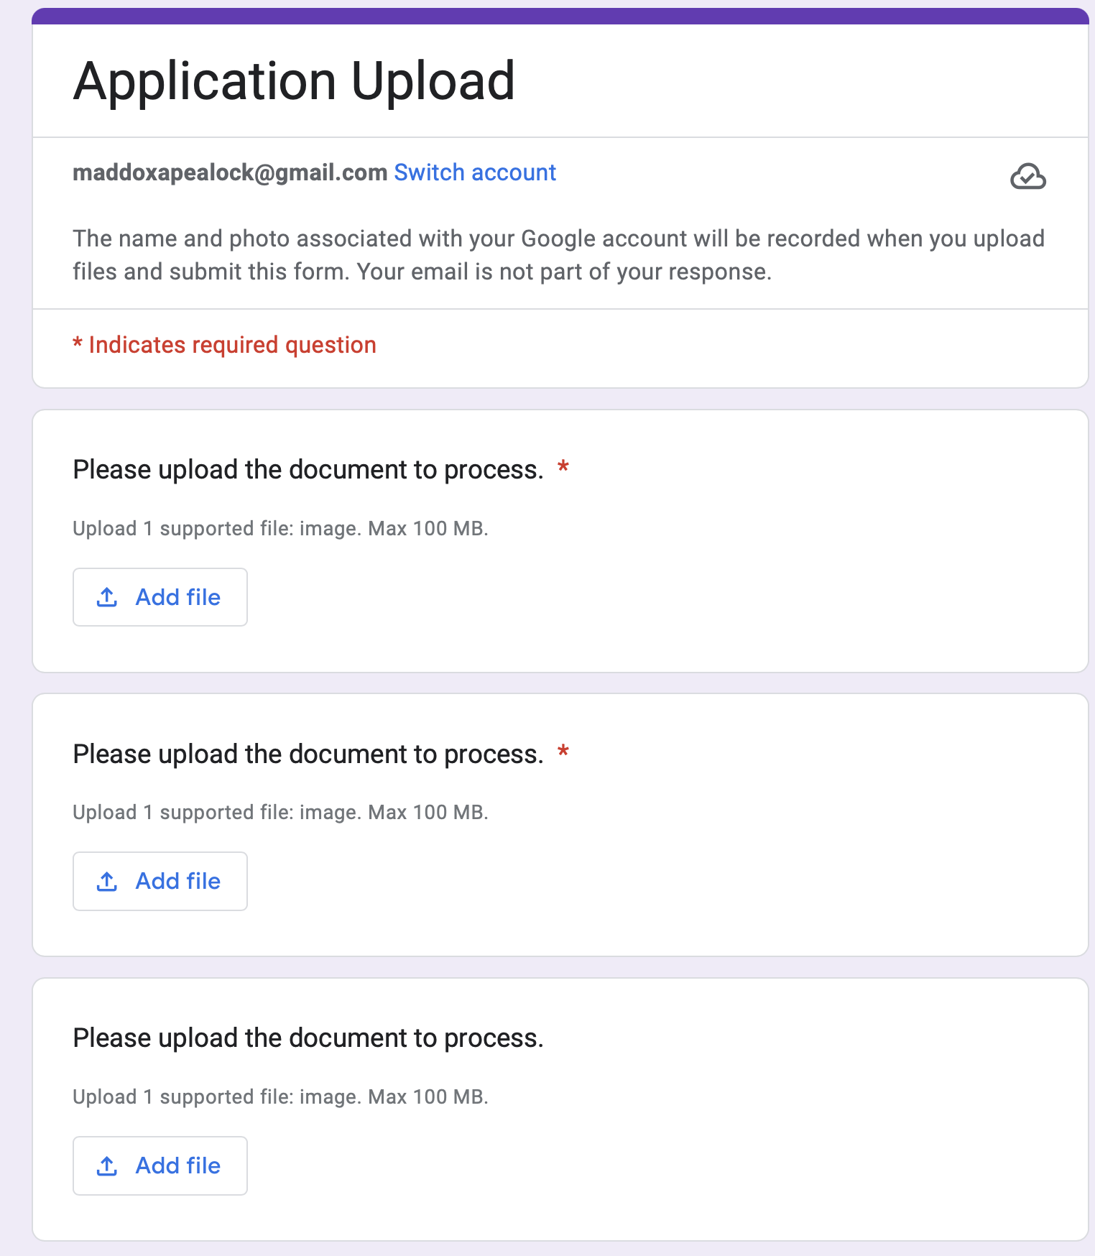
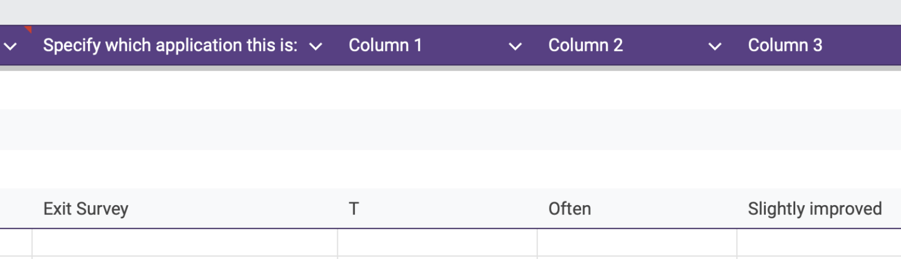
Form Digitizer

Slide 4
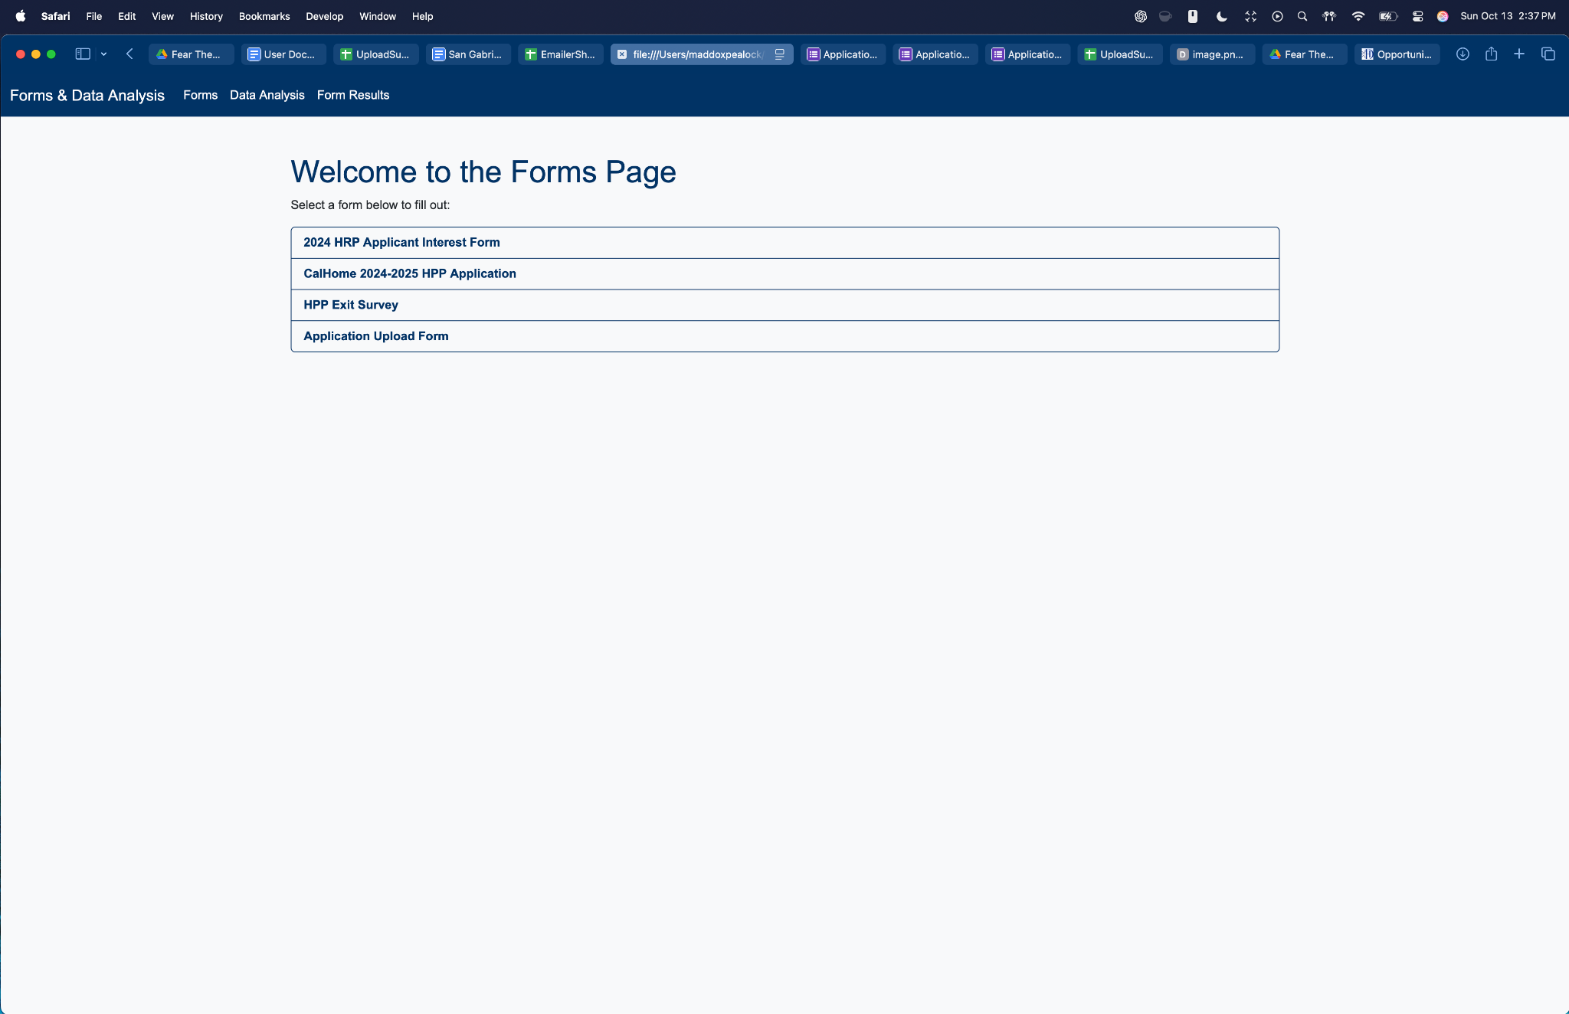
Central Website (Manual Entry)

Slide 5
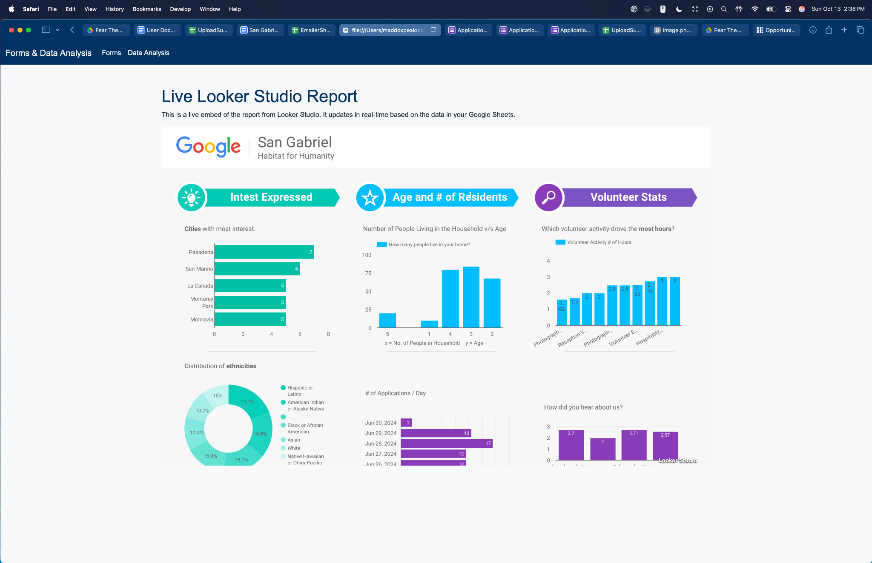
Analysis View

Slide 6
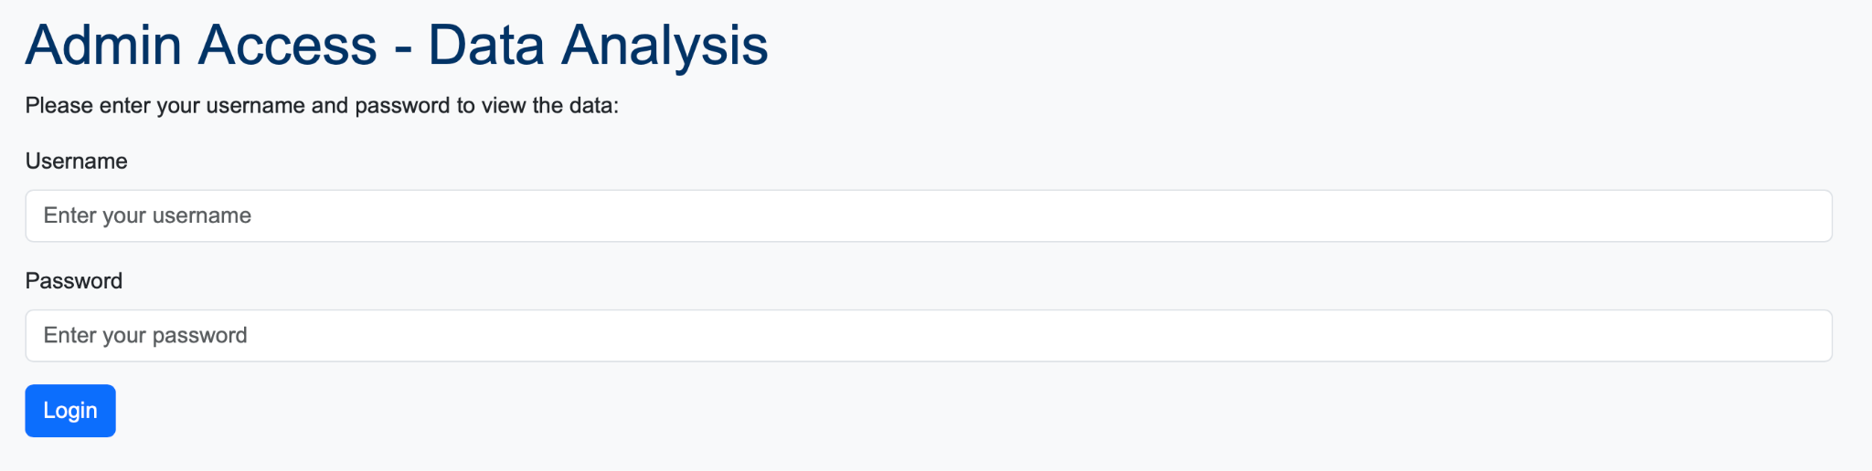
Admin Protection

Slide 7
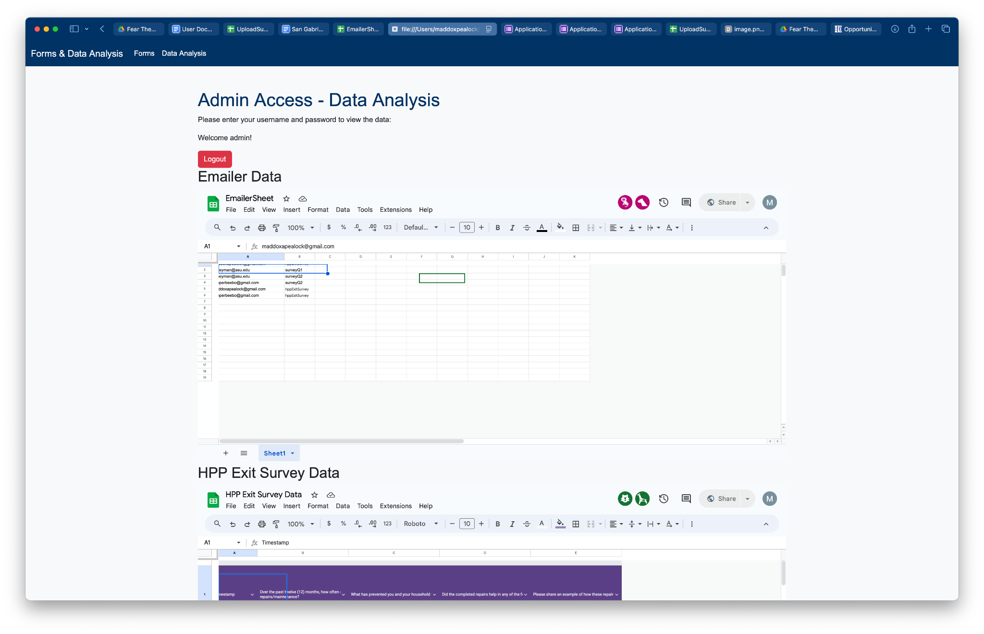
Data View

Slide 8
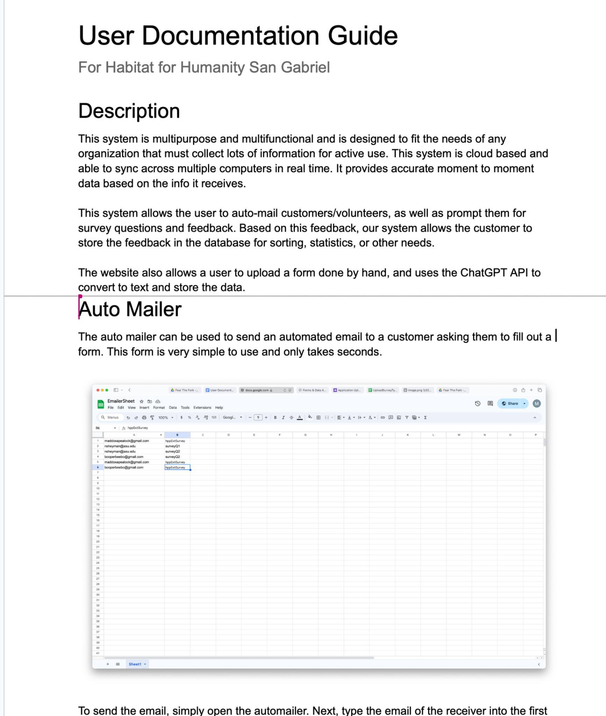
Documentation
Thank You!

